Slide 1
Isótopos estables

Slide 2
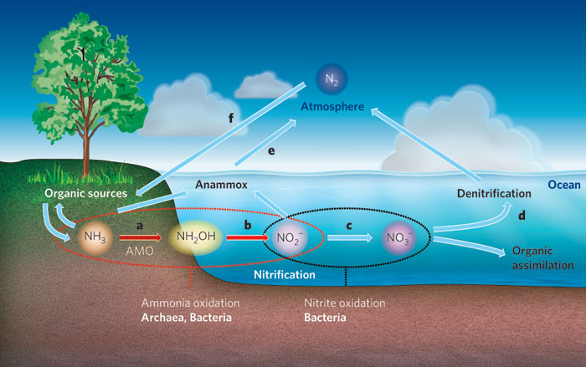

Slide 3
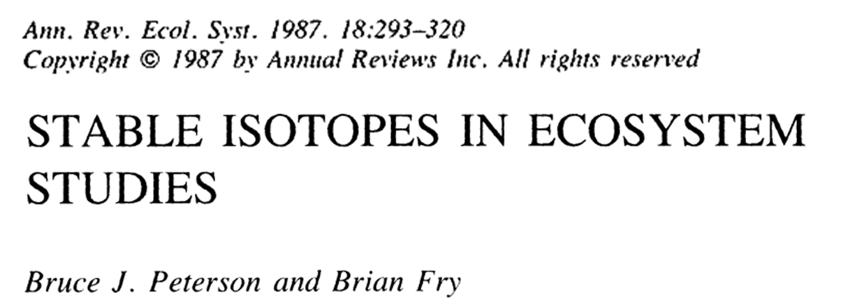
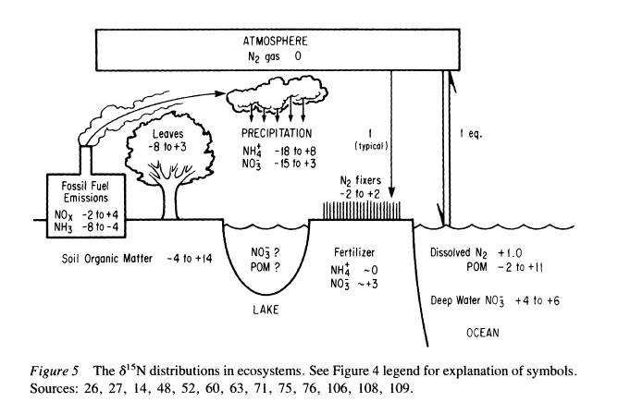

Slide 4
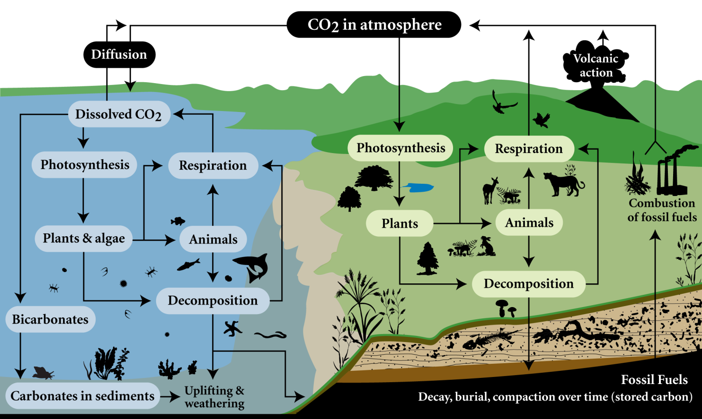

Slide 5
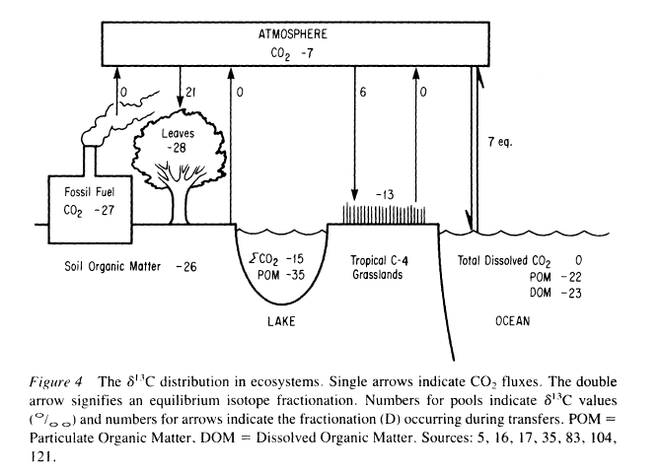

Slide 6
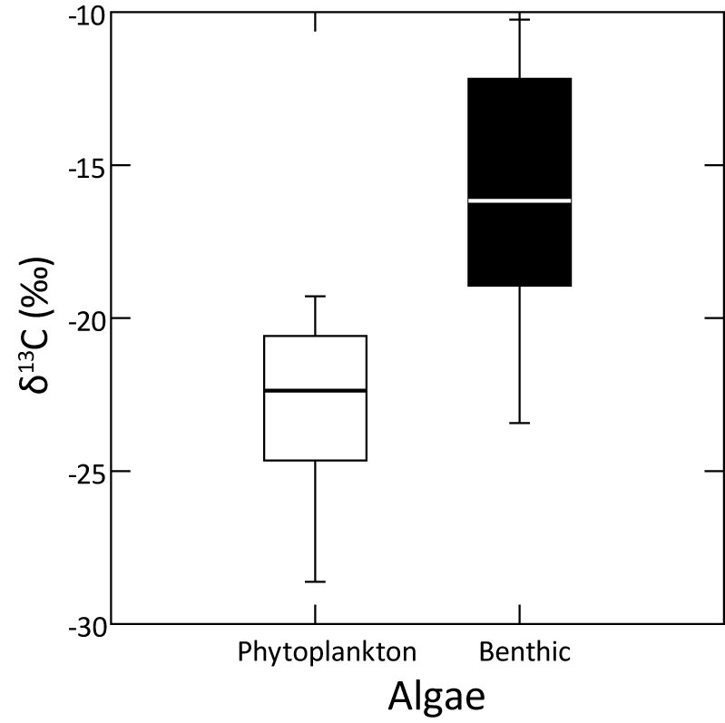
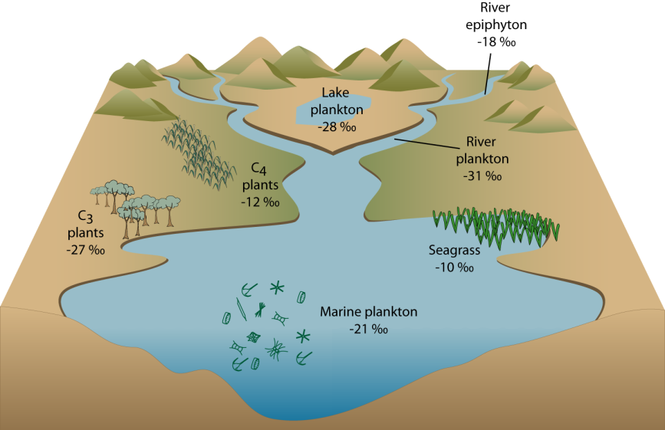

Slide 7
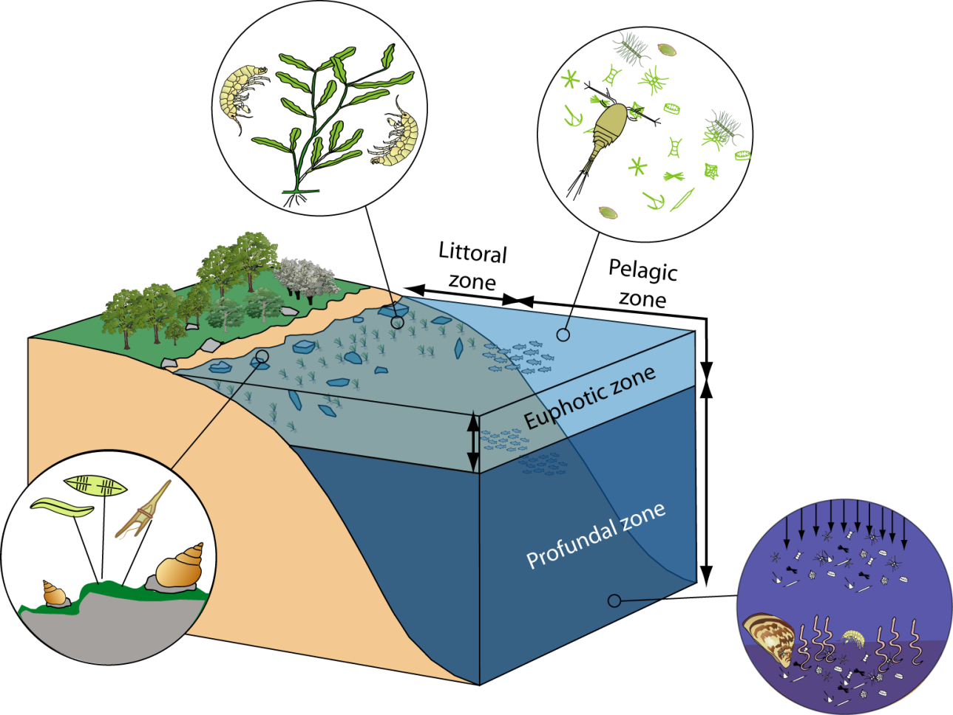
Isotopic variation between habitats – you are where you eat
δ¹³C = -27 ‰
δ¹⁵N = 2 ‰
δ¹³C = -35 ‰
δ¹⁵N = 2 ‰
δ¹³C = -34 ‰
δ¹⁵N = 6 ‰
δ¹³C = -18 ‰
δ¹⁵N = 2 ‰

